Slide 1
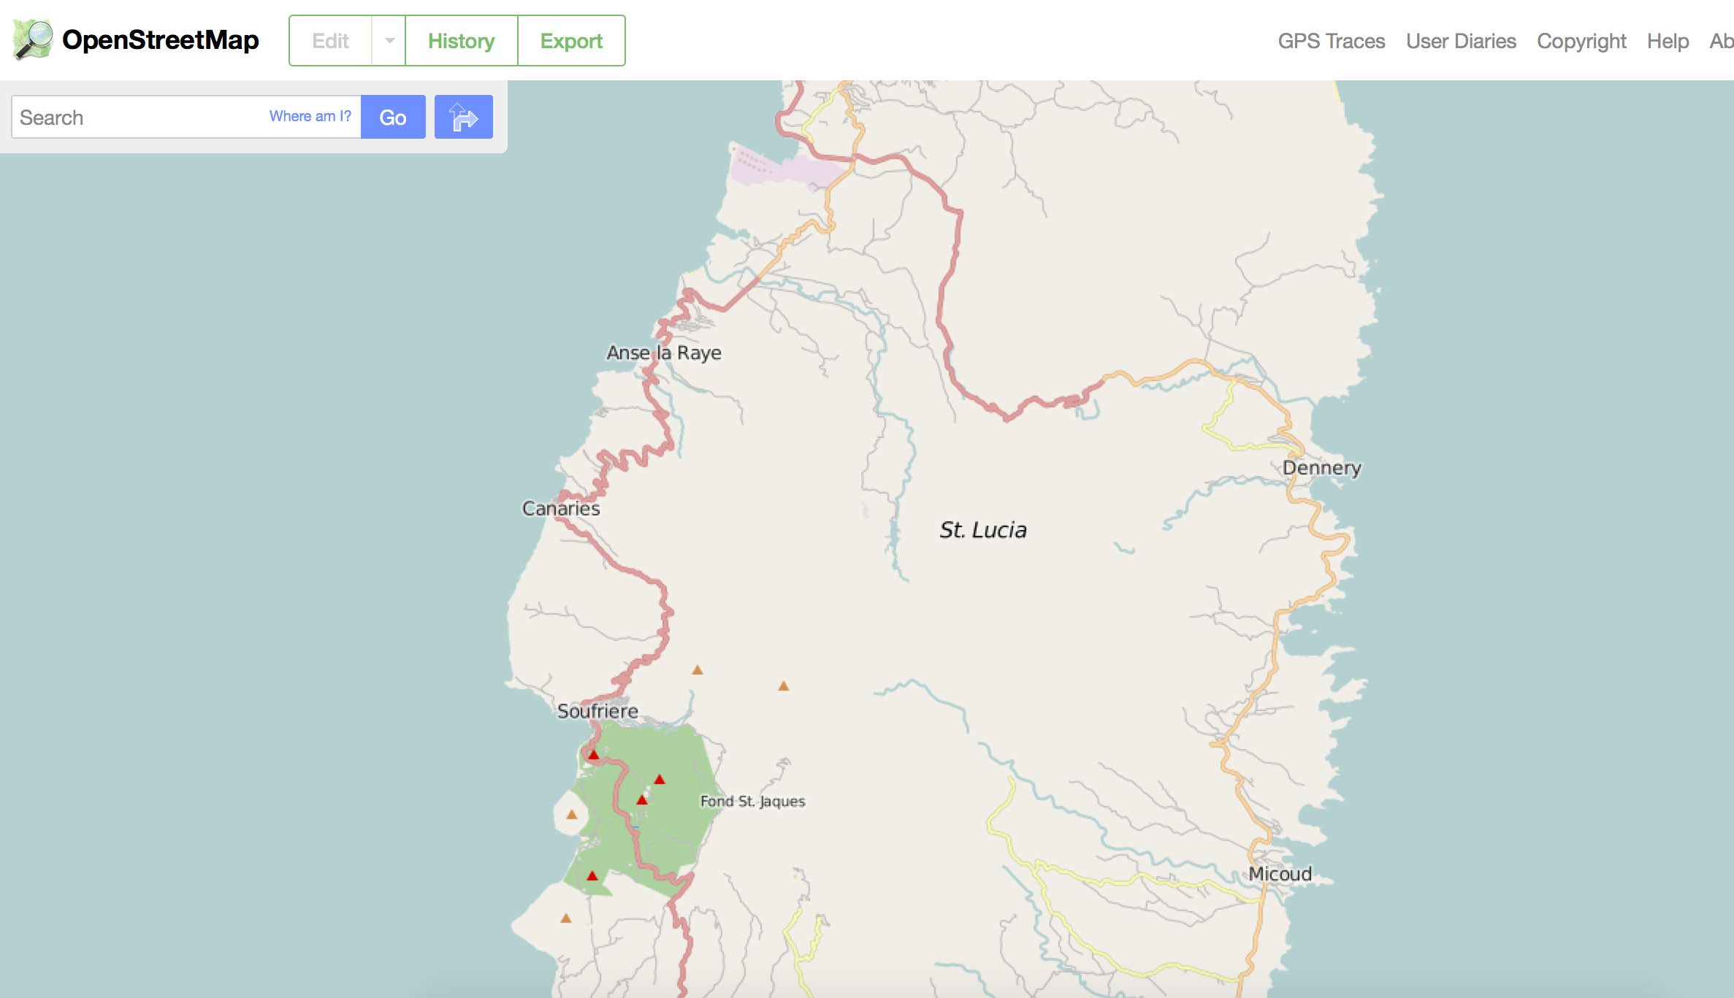
An Overview of Open Mapping & Open Map Data
Maggie Cawley
Steven Johnson

Slide 2
Today’s Agenda
Open Map Data
What is OpenStreetMap?
What is TeachOSM?
Why Create Open Map Data?
Resources for Organizers
Summary

Slide 3
What is OSM?
OSM = OpenStreetMap
OpenStreetMap is a crowd-sourced map of the world with an open content license so anyone edit the map and use the data.
OpenStreetMap is often described as “Wikipedia for maps” as anyone can edit the map.
OpenStreetMap is predicated on open data.

Slide 4
Milestones in OpenStreetMap History…
2004 Frustrated by the inability to access taxpayer-funded government map data, Steve Coast starts OpenStreetMap
2005 - 1000 registered OpenStreetMap users
2006 - OpenStreetMap Foundation established
2009 - 100,000 registered OpenStreetMap users
2010 - 200,000 registered OpenStreetMap users
2013 - 1,000,000 registered OpenStreetMap users
2015 - 2,000,000 registered OpenStreetMap users

Slide 5
How does OpenStreetMap work?
Sign up for an account. Free!
Point your browser to OpenStreetMap.org
Search for your elementary/middle/high school
Not there? Digitize it!
Tag it with address, website, Wikipedia entry, Facebook page, Twitter account, etc.
Save and admire your work!
Pay Attention to Licensing!
OpenStreetMap data are licensed under the Open Database License (ODbL)
Contains a “share-alike” clause
For more info, see: http://opendatacommons.org/licenses/odbl/

Slide 6
Restrictions? There are some…
Don’t use proprietary source data
Violates terms of copyright
No copying from Google!
Make sure data are in the public domain or licensed appropriately
OpenStreetMap is a ‘live’ database
No fantasy mapping!
Enter real, factual data

Slide 7
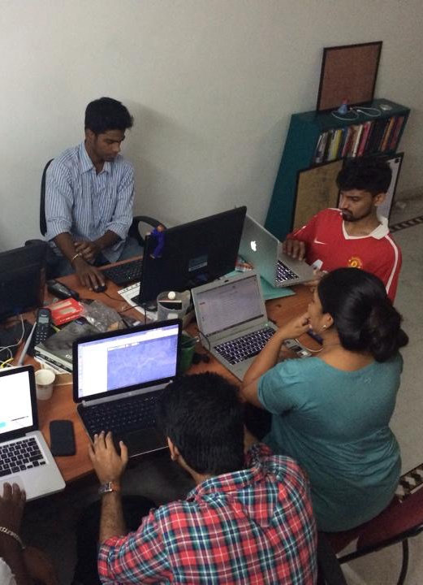
It’s more than a map
It’s an open ecosystem of
Data
Infrastructure
Governance
Communities of Interest
Services
Event driven
Mobilization, mapathons and community events, street surveys
HOT Activations, humanitarian response
MissingMaps and MapGive requests
Photo: Students in India digitizing for Nepal earthquake recovery.
Credit: Gopinath Parayil

Slide 8
Evolving ecosystem of tools
Editors: iD, JOSM
Renderings: Mapnik, CSS, Mapquest, OpenCycleMap
Data Collection: Field Papers
Streetview: Mapillary photo app
Scheduling: Tasking Manager
Data quality: Overpass Turbo, MapRoulette
Export: XAPI, MapTiles

Slide 9









Growing Commercial Adoption of OpenStreetMap
Telenav
Geofabrik
ITO
Mapbox
CartoDB
Foursquare
Craigslist
Washington Post
…and more!

Slide 10








Government Use of OpenStreetMap
Indonesia - Risk Reduction, Exposure Mapping
Haiti - Basemap, Reconstruction, Economic Development
United States - National Park Service, Geological Survey, State Department, USAID, & others for
Tanzania - Flood hazard mapping
Mongolia - Risk reduction, economic development
…and many others

Slide 11
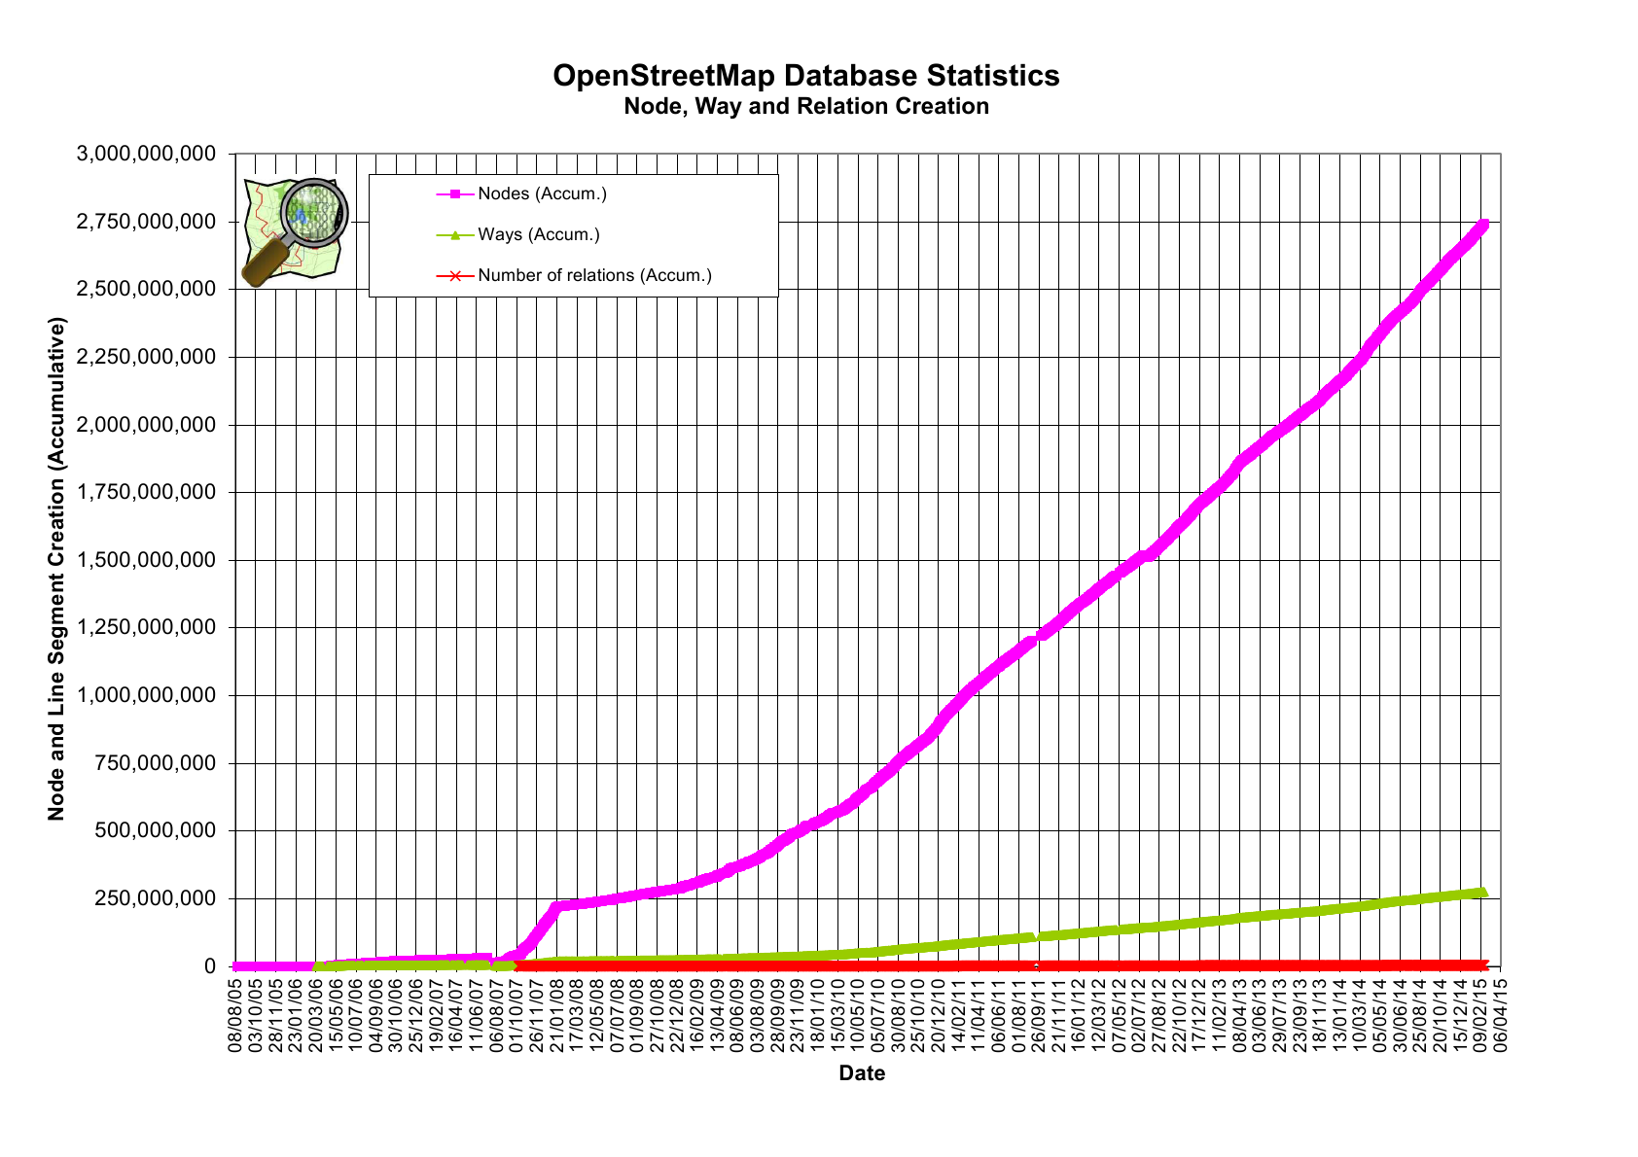

Slide 12
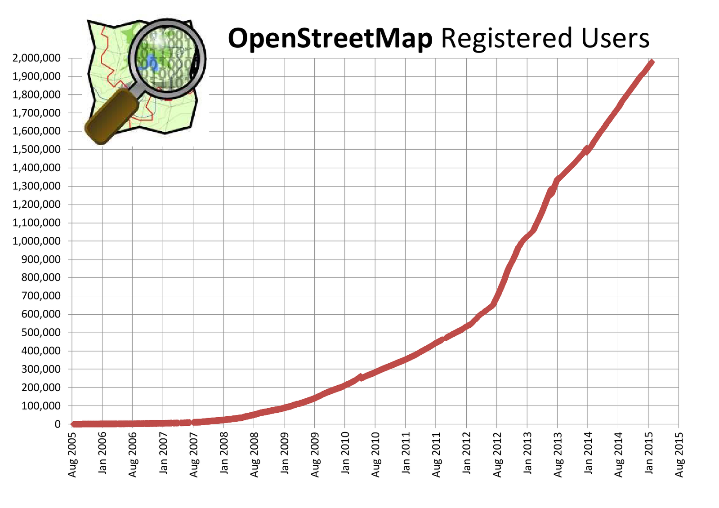

Slide 13
The value of OpenStreetMap is not the map
…it’s the data!

Slide 14
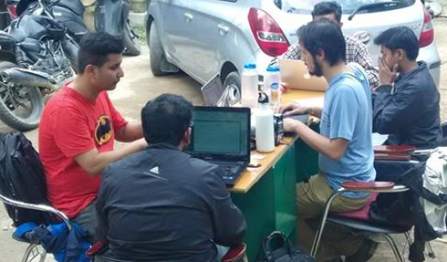
Highlight: OpenStreetMap and Nepal Earthquake
OpenStreetMappers in Nepal one day after quake.
Credit: PierZen

Slide 15
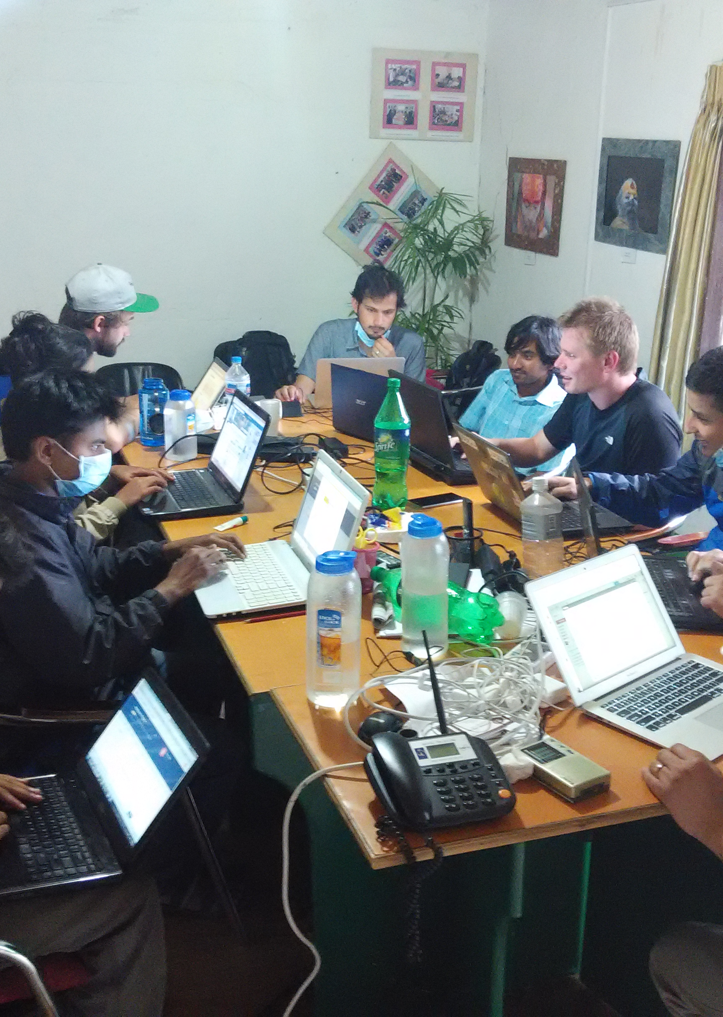
OpenStreetMap Plays Key Role in Disaster Relief
Mobilization began on 25 April within hours of quake
~2300 mappers actively mapping around the world
71786 edits to highways, 143372 edits to buildings, 33806 changesets since April 25, 2015.
Maps used by rescue & recovery specialists, NGOs, government agencies
Photo: OpenStreetMappers at Kathmandu Living Labs one day after the quake.
Credit: KLL

Slide 16
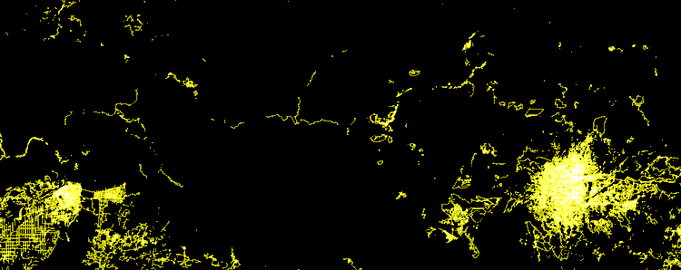
Post-quake edits to OpenStreetMap in Nepal
Credit: Eric Fischer
https://www.mapbox.com/blog/nepal-earthquake-animation/

Slide 17
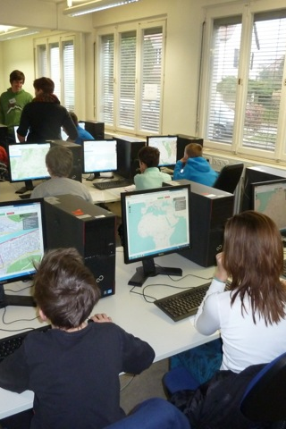
TeachOSM: A Resource for Open Map Data
Infrastructure for Organizers
Photo: middle-school school students learning to map.
Credit: MaptimeLex/Lyzi Diamond

Slide 18
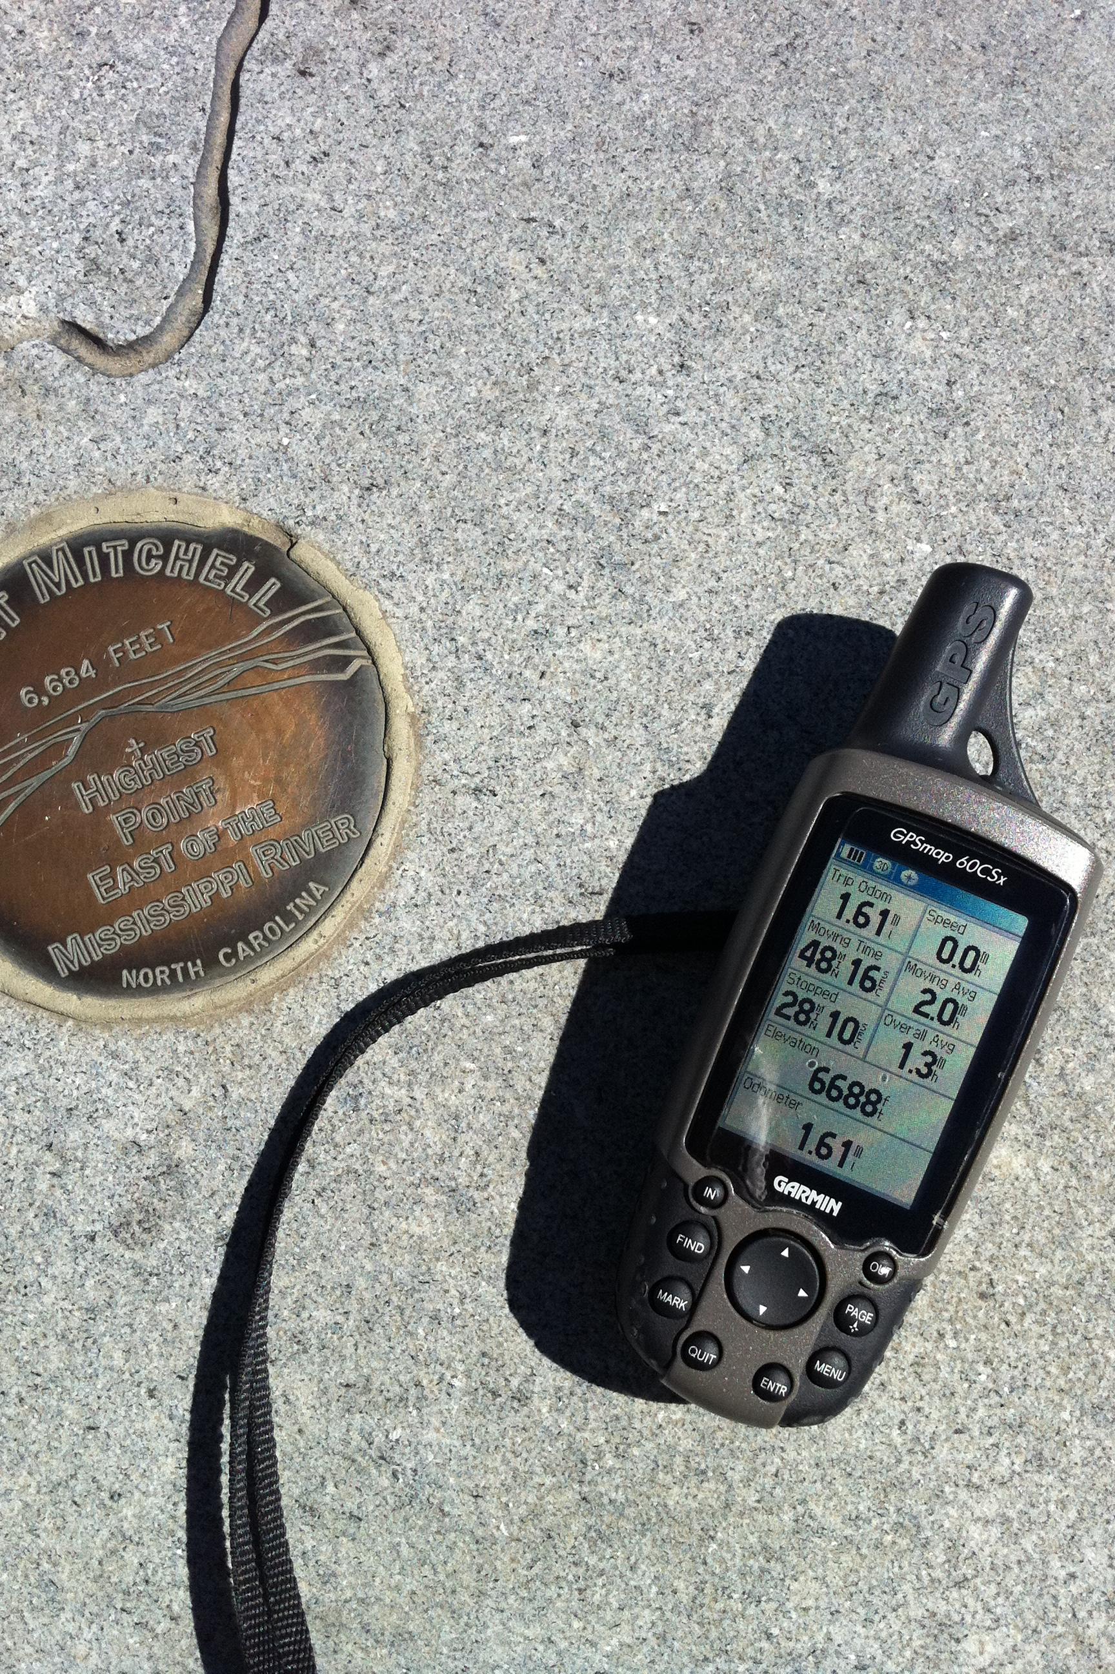
What is TeachOSM?
TeachOSM is a growing resource for trainers & educators at all levels to introduce open source mapping in their classes & trainings.
TeachOSM offers modular lessons in applied mapping using OpenStreetMap.
TeachOSM has resources to help instructors to identify, assign, manage and assess a mapping data quality.
Photo: Mapping peaks using GPS.
Credit: SEJohnson

Slide 19
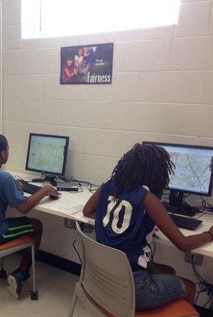
For Technicians…
Acquire basic digital mapping skills
iD map editor
TeachOSM Tasking Manager
Expand opportunity for vocational learning
Service opportunities in mapping:
Humanitarian OpenStreetMap Team (HOT)
MapGive
MissingMaps
Cultivate geo-literacy through guided mapping projects
Photo: middle-school school students learning to map.
Credit: SEJohnson

Slide 20

For Organizers…
Basic map editing skills
Organizing & managing your mapping event
Using the Tasking Manager, for assigning blocks of work
Quality control, assessment, validation procedures
Ready-made projects for you to adapt to your local conditions
Photo: Mapathon, Spring 2014.
Credit: Brian DeRocher

Slide 21



GeoBadges: Micro-credentials for Mapping Skills
A new initiative to give credentials to mappers and instructors for contributions to OpenStreetMap
Expectations:
Contribute to the map & foster community
Be a Resource for Peers
Develop an Understanding of Basic Digital Mapping Constructs
Contribute to Community Mapping Goals (local, HOT, MapGive, MissingMaps)
Web: http://geobadges.org/

Slide 22

Highlight: TeachOSM and the Georgia Avenue Project
Training Young Adults to Map

Slide 23
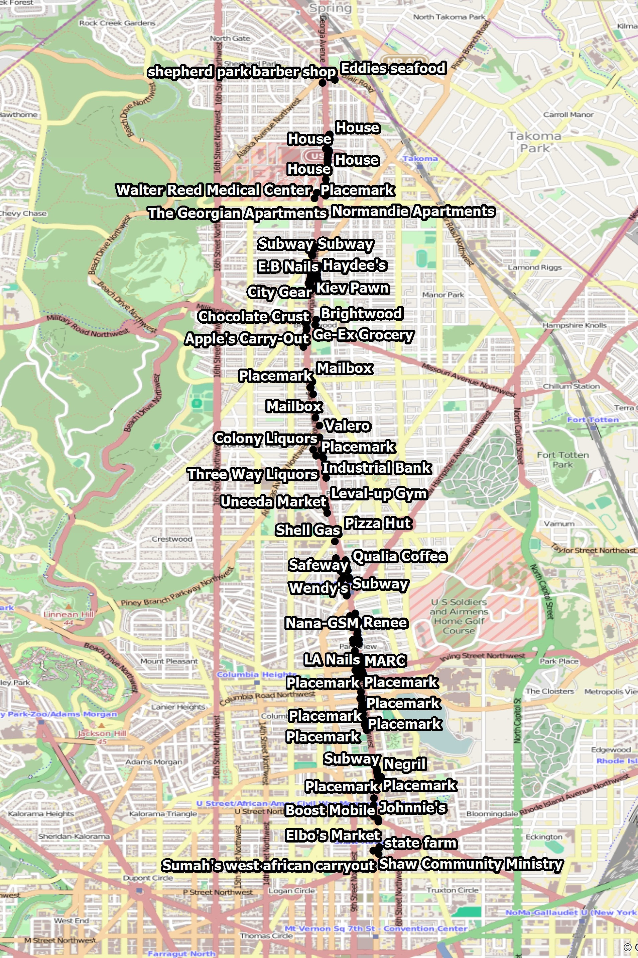
Georgia Avenue Mapping Project
Youth Ambassadors used Georgia Ave data gathered for street-level survey
We trained ~15 Youth Ambassadors in how to edit in OpenStreetMap
Results:
Over 270 features added to the OpenStreetMap
Survey data visible on the map!
http://wiki.openstreetmap.org/wiki/Georgia_Avenue_Youth_Ambassadors_Mapping_Project

Slide 24
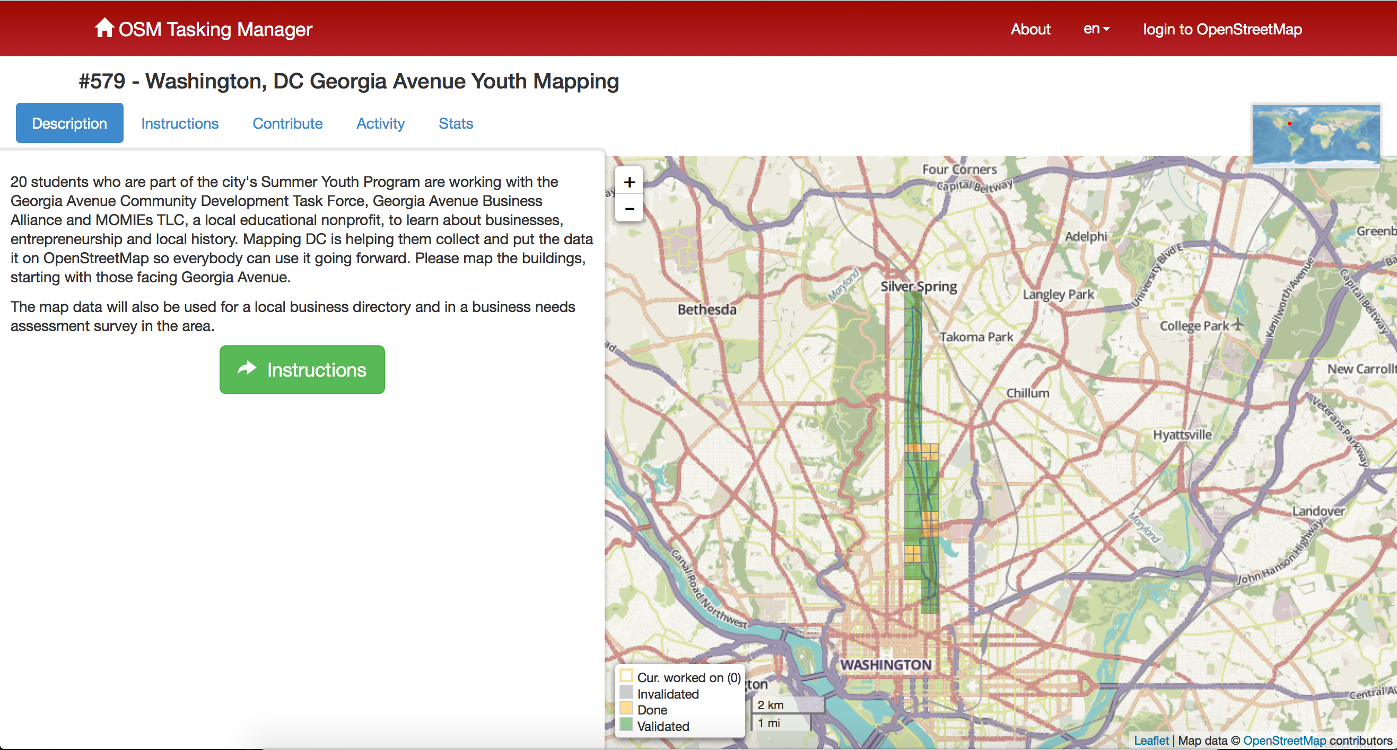
Using the OSM Tasking Manager to control workflow

Slide 25
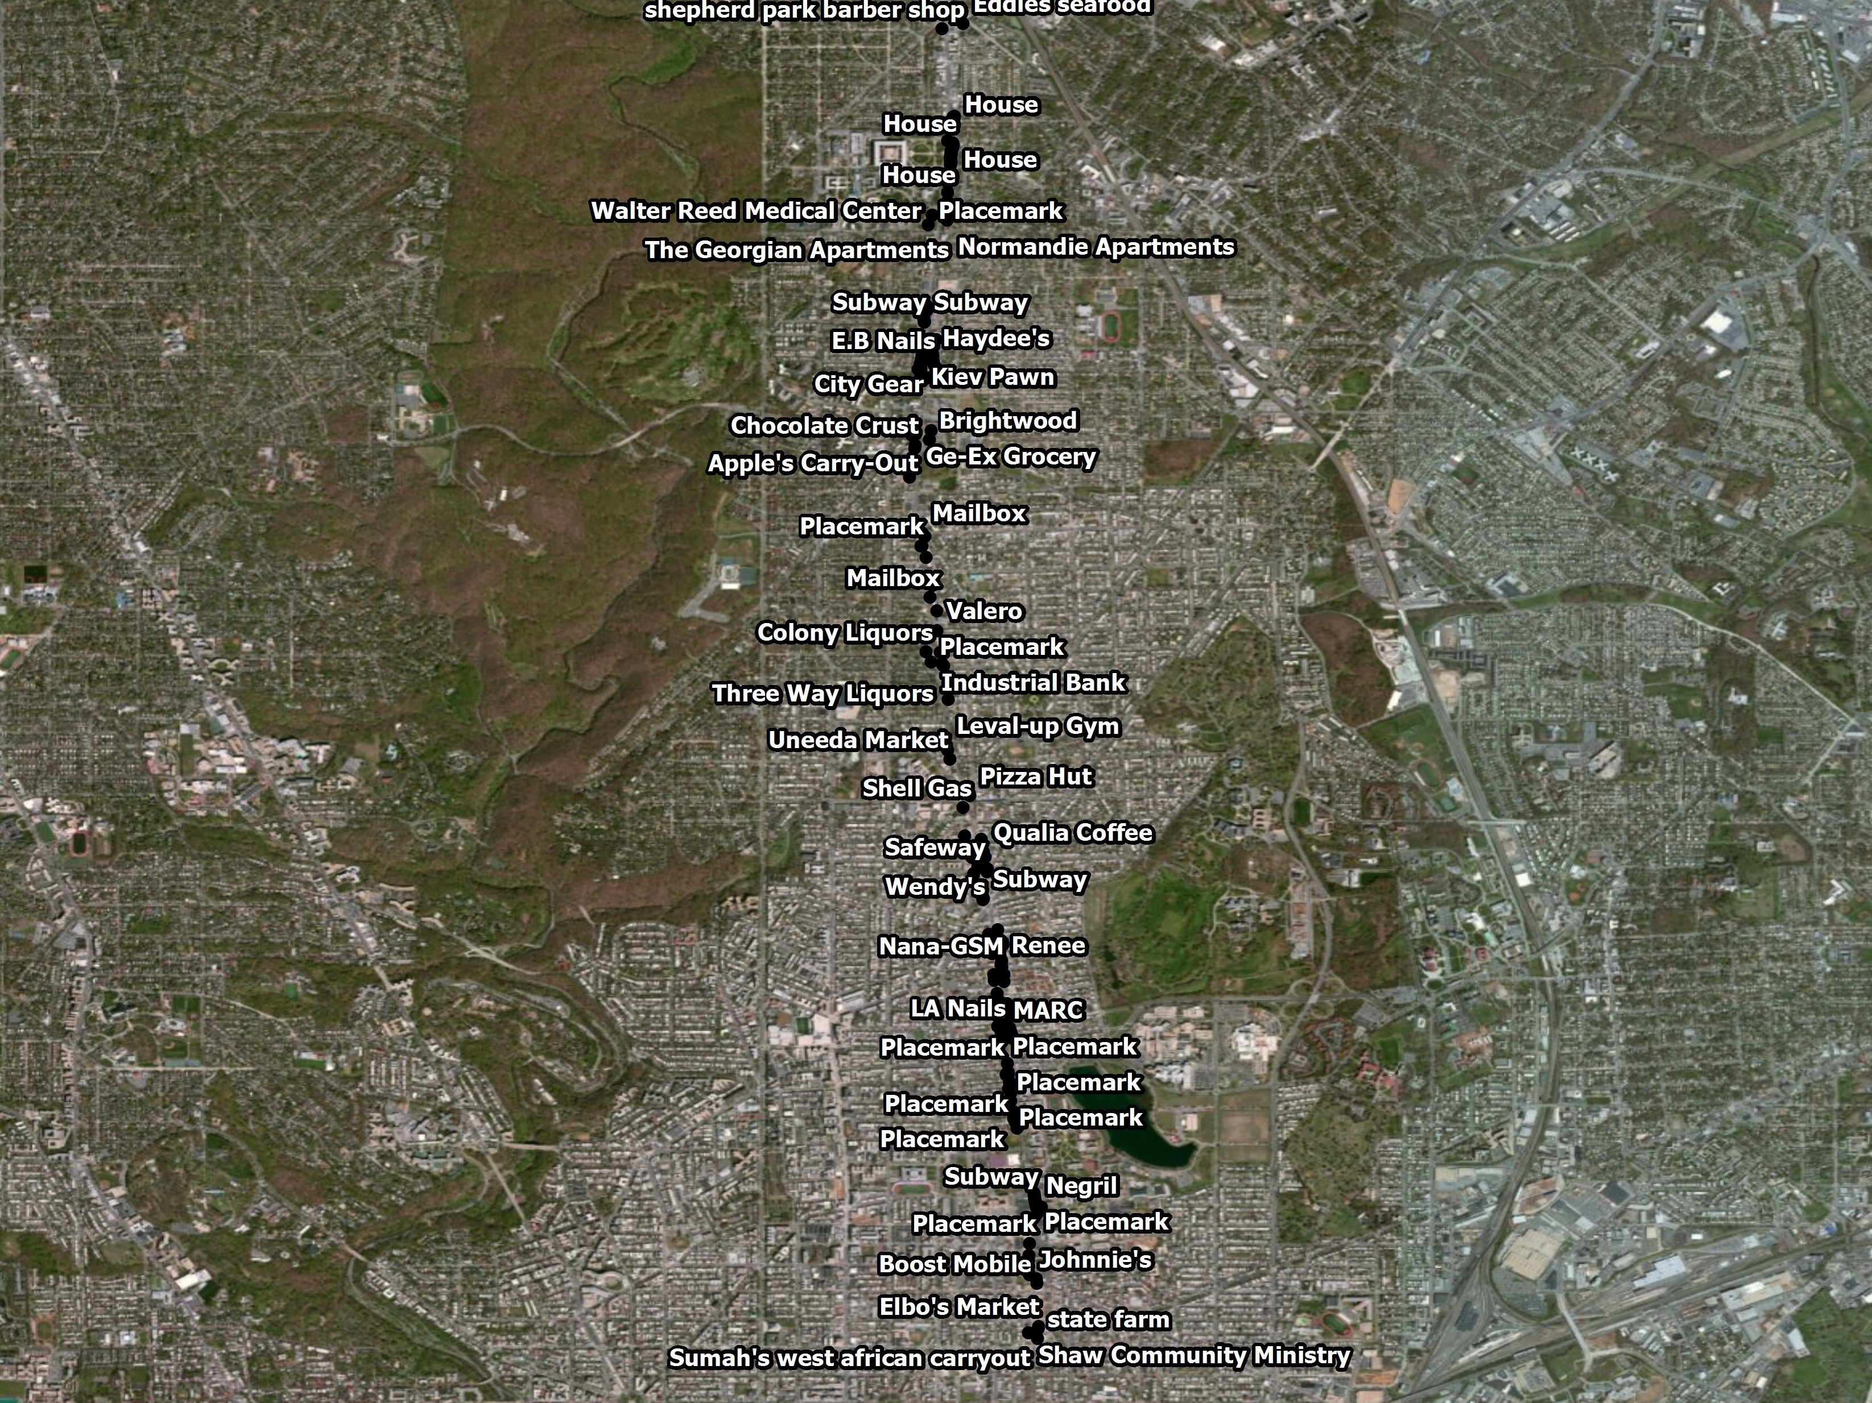

Slide 26
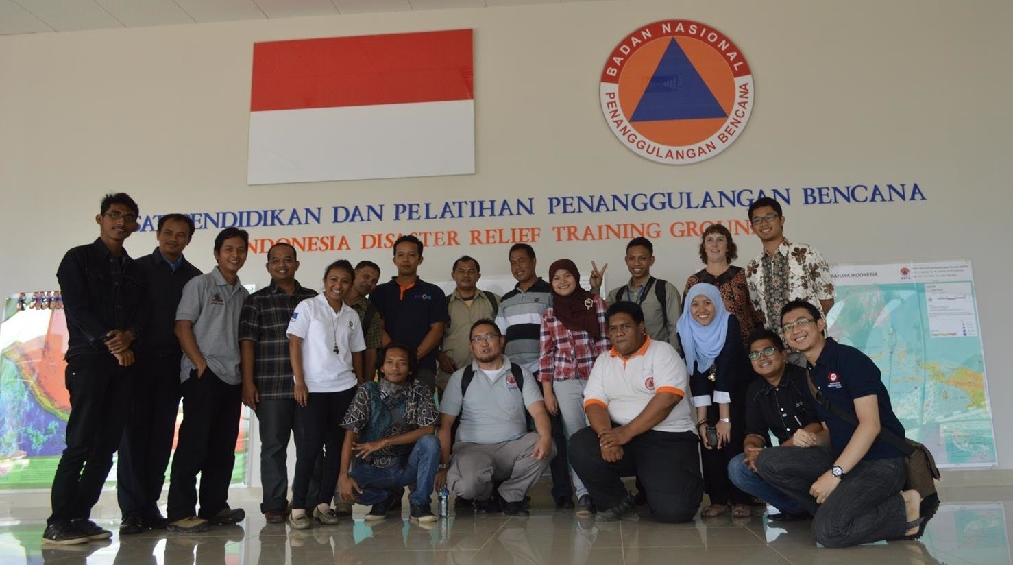
Highlight: HOT Indonesia
University Outreach Program

Slide 27

University Outreach & Contingency Planning
Focus is disaster preparedness and contingency planning for vulnerable areas
Working with local communities to identify & map exposure and risk
Using QGIS & InaSAFE plugin for downstream analysis
Over 4 years, conducted 86 trainings, 2300 people trained, ~2m buildings, ~14500 schools

Slide 28
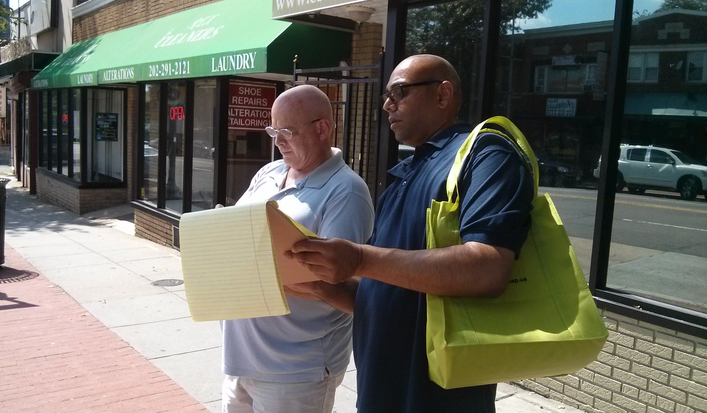
Highlight: DC Great Streets Survey
Business improvement

Slide 29

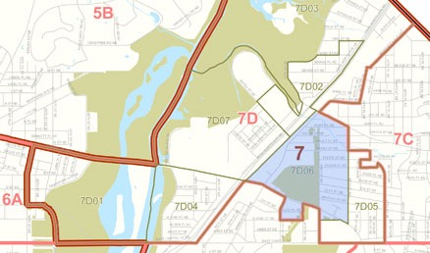

Creating a Street Survey
DC City government evaluates storefront conditions to determine eligibility for small business loans
Using Mapillary, mappers take photos of storefronts
Photos are ‘geo-coded’ and sequenced to produce an open source street view
Photos are used to assess storefront conditions

Slide 30
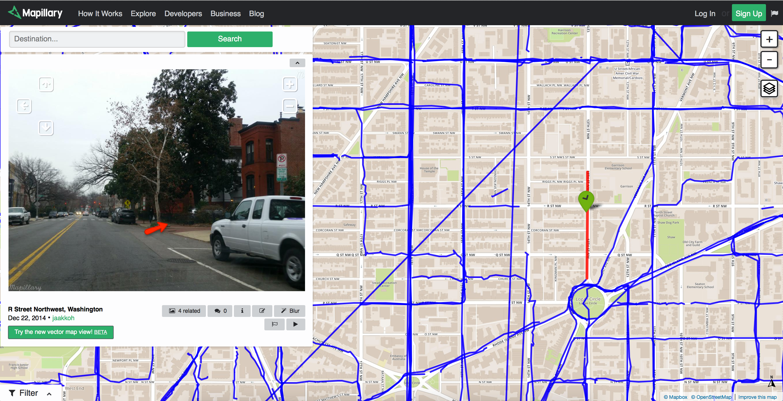
Open Source Street View Using Mapillary

Slide 31
Criticisms and Vulnerabilities
What about data quality?
Yesterday: positional accuracy
Today: currency
“Gardening” as a technique for maintaining the map
Muki Hakley and the value of citizen science
What about vandalism?
“Edit wars”
“With enough eyes, all bugs are shallow.”

Slide 32
Why TeachOSM?
Five Reasons why OpenStreetMap is an effective tool for community development & social engagement

Slide 33
OpenStreetMap Gives Participants Immediate Experience of Local Geography
Experiential geography - Active mappers gain direct experience of space, place, and location
Geography at a 1:1 Scale
The terrain is the map
Cultivate an understanding of how to read the landscape
Fundamental to Geo-Literacy

Slide 34
Contributing to OpenStreetMap adds to the open data commons
Opportunities to engage in community service through mapping
OpenStreetMap is a way to maintain map in your neighborhood
Contribute to Humanitarian OpenStreetMap Team mapping tasks
Use MapRoulette ‘micro-tasking’ to help improve map quality

Slide 35
Build Social & Economic Capital Through Mapping
Provides meaningful engagement for entrepreneurs that can broaden academic & career options
Expand technical capital
The open platform encourages self-guided learning and allows mappers to challenge themselves.
Mapping projects encourage collaboration & teamwork
Plan for the communities we want to live in

Slide 36
OpenStreetMap Requires No Special Resources
No software required - works in the browser
No permission required - OSM is a do-acracy: DO IT!
Data are free and can be exported for downstream use in desktop GIS packages (e.g. QGIS, ArcGIS)
Data can be re-combined with other data (e.g. government open data, aerial imagery, etc)
No fees, licensing charges, royalties, paywalls, subscriptions, etc.

Slide 37
Proprietary maps don’t always meet needs
[Suitland Fed Ctr comparison]
[Castries comparison]

Slide 38
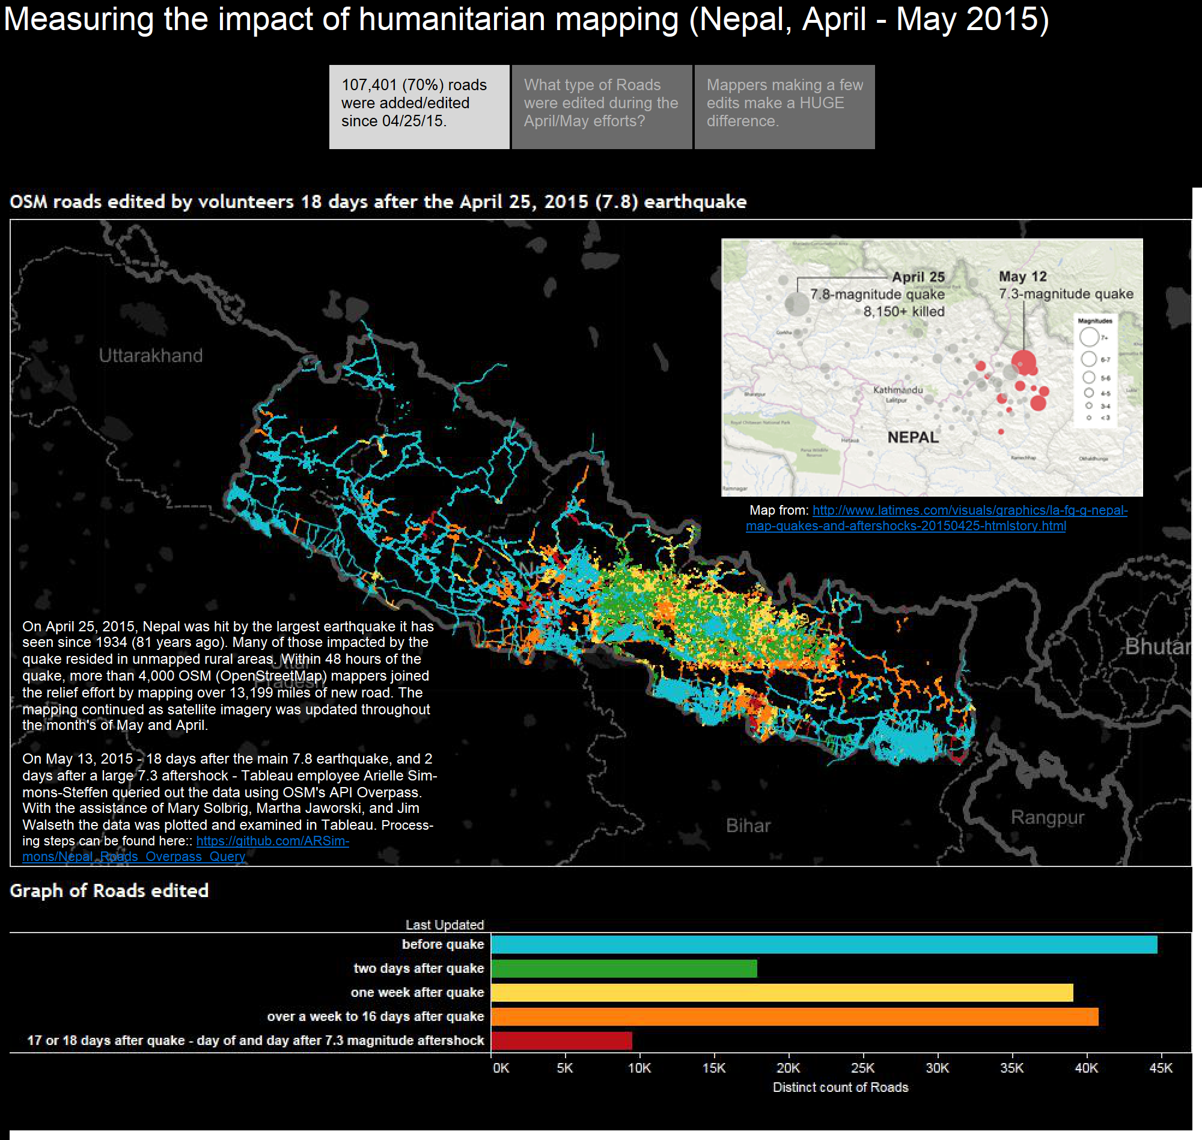
Crowd-sourcing adds capacity: Post-earthquake edits to OpenStreetMap in Nepal

Slide 39
Sample Ideas for Projects
Conduct a street survey for economic development :
http://teachosm.org/en/cases/DCGreatStreets_survey_casestudy/
Map for disaster relief/preparedness:
http://mapgive.state.gov and http://missingmaps.org/
Add historical features to OpenHistoricalMap:
http://ow.ly/MfhZw
Map local food resources:
http://teachosm.org/en/cases/farmers-market/
Start a student mapping society:
https://www.facebook.com/GWHMS

Slide 40

Ready to Map?
Where do I get started?
Subscribe to the TeachOSM mailing list
Send an inquiry to info@teachosm.org
How do I contribute?
Create Tracing Guides specific to Caribbean land uses & building types
Organize a mapping project (Yes, we can help!)
Help refine our materials
Photo: middle-school school students learning to map.
Credit: MaptimeLex/Lyzi Diamond

Slide 41
Summary
As an open freely editable map of the world, OpenStreetMap is an excellent platform for teaching geography and for community engagement
OpenStreetMap offers students geo-literacy, social ties, service learning, and independent learning opportunities.
OpenStreetMap is free and requires no special equipment
Use TeachOSM and help us make it better

Slide 42
Resources for OpenStreetMap-based projects
TeachOSM - http://teachosm.org/ - Resources for educators & trainers
LearnOSM - http://learnosm.org/ - Comprehensive resources for mapping
QGIS - http://qgis.org/
GeoBadges - http://geobadges.org/
MapGive - http://mapgive.state.gov
MissingMaps - http://www.missingmaps.org/
Humanitarian OpenStreetMap Team (HOT) - http://hot.openstreetmap.org/
Real-time contributions to OSM in Nepal: http://osm.townsendjennings.com/nepal/
OSM wiki page on Nepal earthquake: https://wiki.openstreetmap.org/wiki/2015_Nepal_earthquake

Slide 43
Questions?

Slide 44

Thank You!
Steven Johnson, Principal
Geomantic Labs
sejohnson8@gmail.com
@geomantic
geomantic
Maggie Cawley, Founder
Boomerang Geospatial
maggie@boomgeo.com
@maggiemaps
mcawley

Slide 45

Contents of this document are licensed under Creative Commons Attribution & Share-alike license: https://creativecommons.org/licenses/by-sa/4.0/

